Slide 1
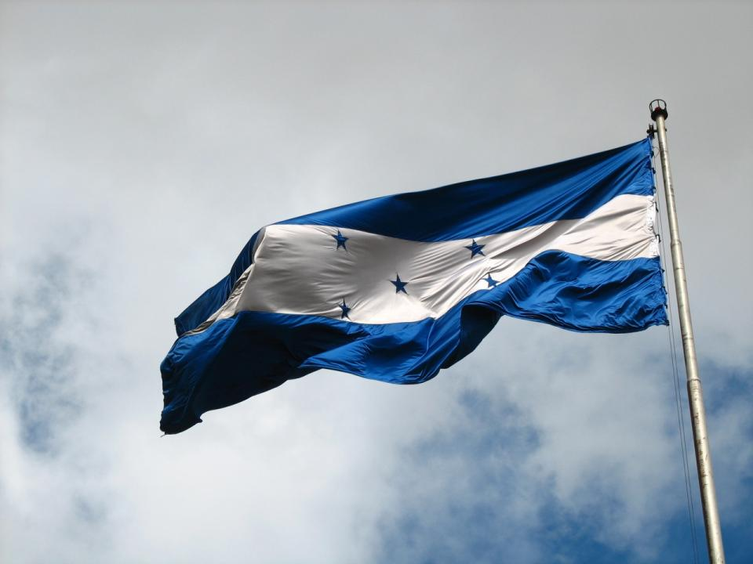
Honduras
1838

Slide 2
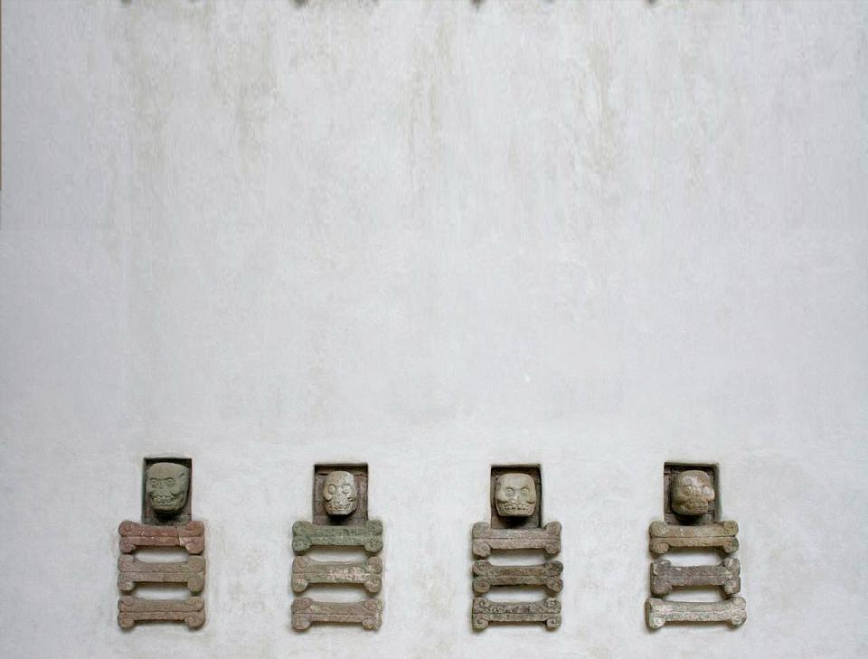
History
Great Mayan Empire flourished in present-day Honduras until about 800 ad
Columbus landed in 1502 and called the area Honduras
Last of Indians chiefs were killed after several groups of natives fought till 1539
Spain granted Honduras independence on September 15, 1821

Slide 3
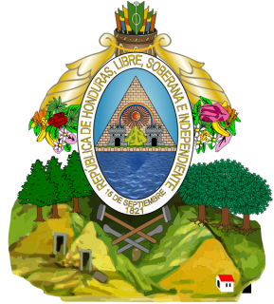
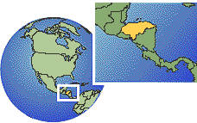
Government
The republic of Honduras is divided into 18 departments, administration by a governor
The unicameral Congreso Nacional has 128 seats
Party affiliation is taken seriously
The Honduran president is chief of state and head of government

Slide 4
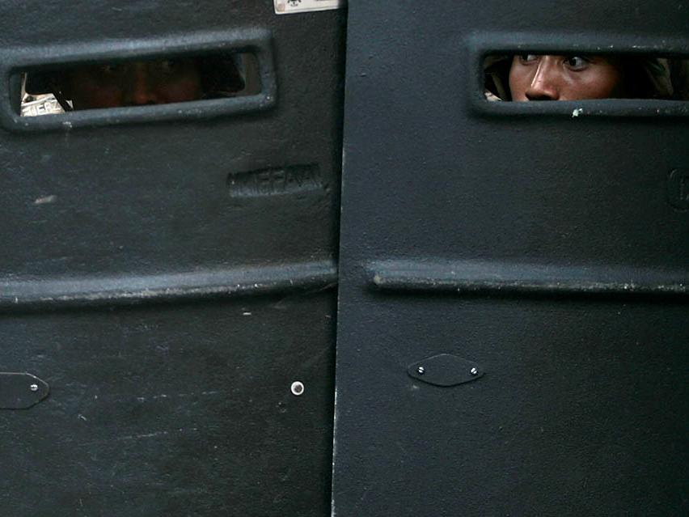
Recent Political Turmoil
President Jose Manuel Zelaya was ousted as president of Honduras during the first military coup in Central America since the cold war
Zelaya is presently slated to return to his post as president to serve his last few months as president
Political opinion remains divided on whether Zelaya should have been ousted

Slide 5
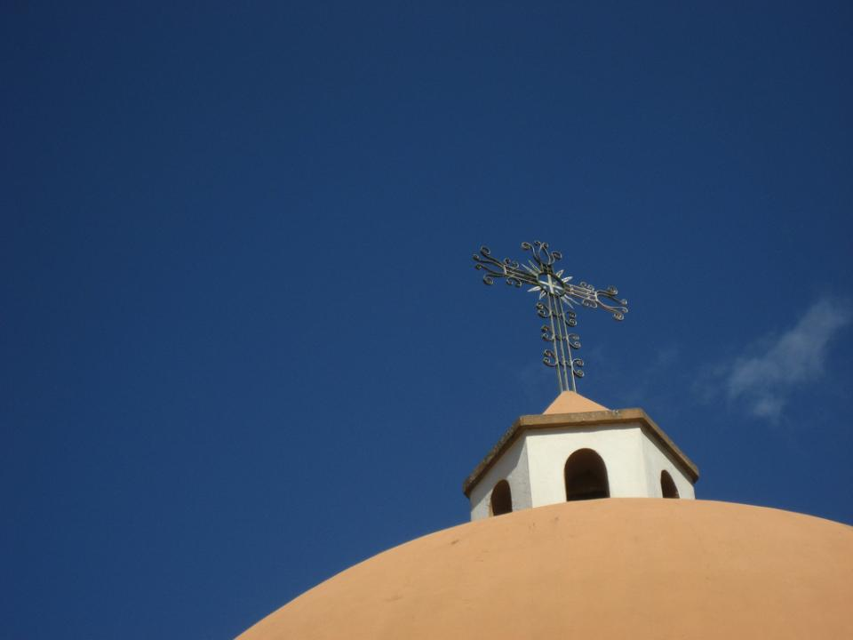
Religion
Majority of Population is Roman Catholic
Various other Christian groups are active
Most protestants attend church regularly
Catholic church maintains influence on society through festivals, family celebrations

Slide 6
Culture
Dressing up in Honduras for special occasions is important
Rural women do not work outside the home
Being late for appointments or events is a way of life
Hondurans often wear western style clothes

Slide 7
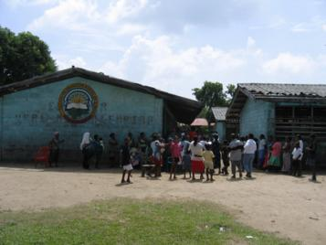
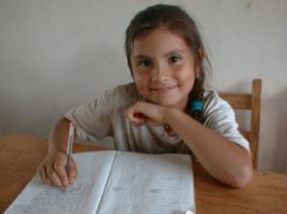
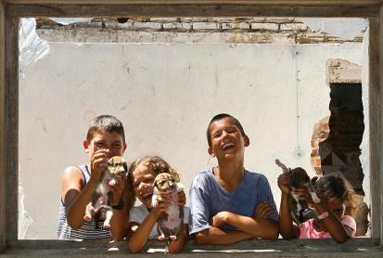
Education
Schooling is required from age 7 to 13
Less than half complete full 6 years, less than one-third advance to secondary level
Children in school cannot help with chores and farming, which can be a burden for some families
Honduras has some of Central America’s best agriculture and forestry schools

Slide 8
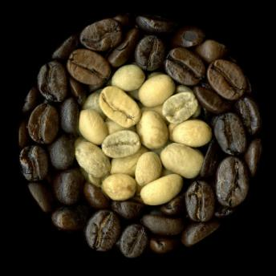
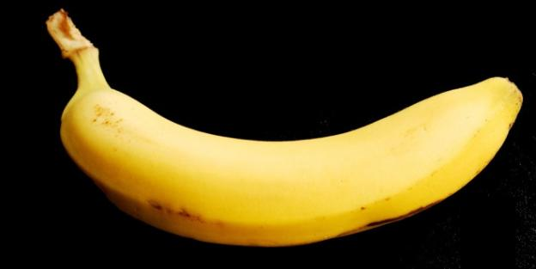
Economy
Honduras is one of the poorest countries in the western hemisphere
More than half of population in poverty, many people don’t earn income
Most exports are bananas, coffee, followed by seafood
The Honduran currency is the Lempira (HNL)

Slide 9
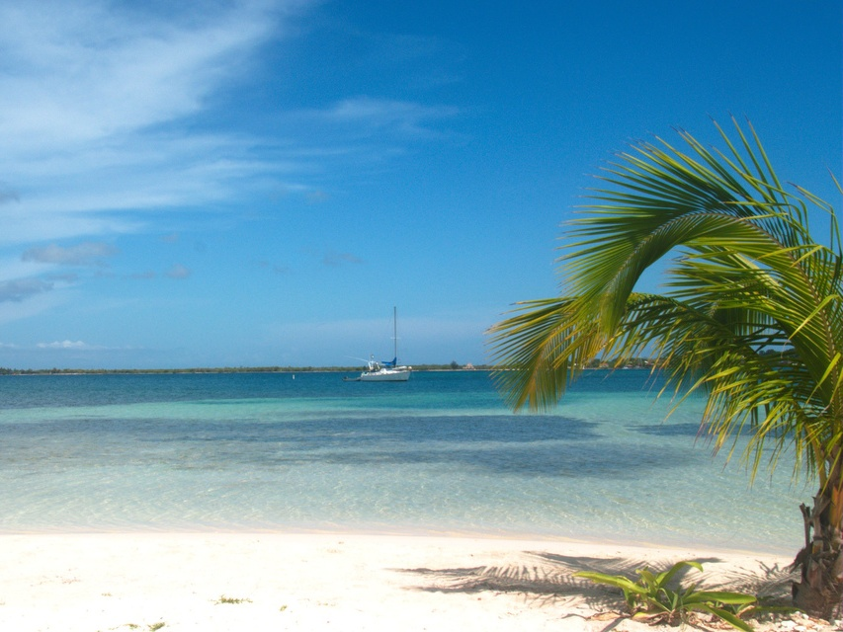
Physical Features
Honduras is larger than Tennessee
Honduras is mountainous
It is the only Central American county without Volcanoes
They have poor soil, many practiced migratory agriculture, moving every few years to clear land and crops

Slide 10
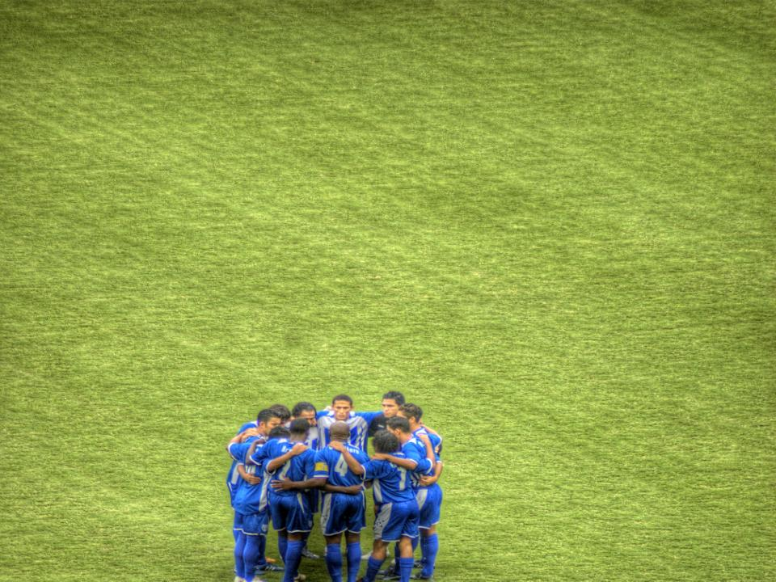
Sports/Entertainment
Futbol ( soccer) defines national recreation
Boys/men play regularly in leagues , and professional competition
Girls are more likely to play basketball
Wealthy Hondurans enjoy cycle races, baseball, golf, tennis, and swimming

Slide 11
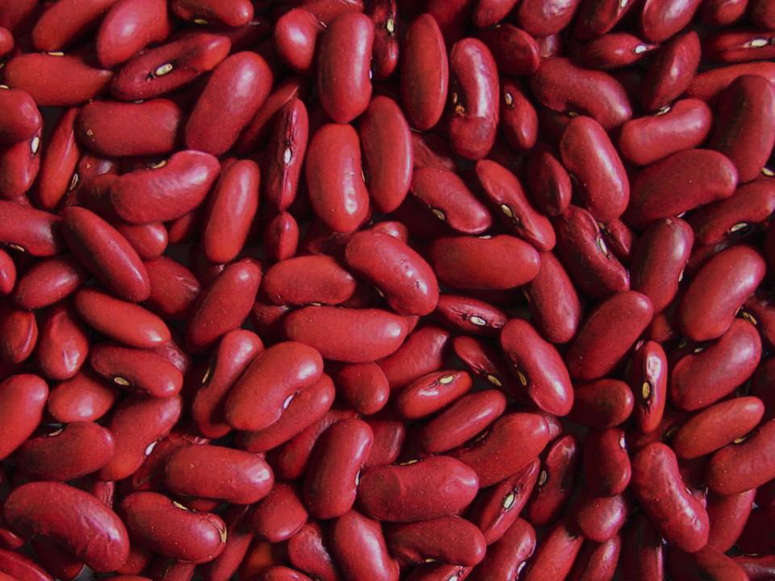
Food
Red beans, corn, tortillas, and rice are stable foods
Special dishes include tapado (stew beef, veggies, and coconut milk
Mondongo( tripe and beef knuckles), nacatamales( pork tamales), torrejas( French toast) are dishes
People love enjoying soft drinks or coffee with or without milk

Slide 12
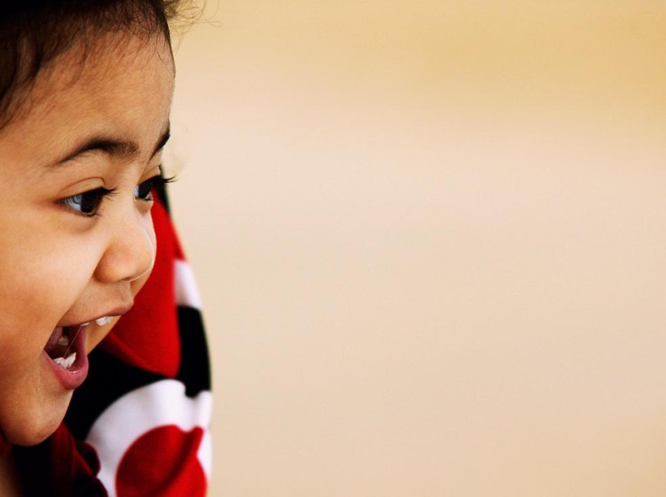
Fun Facts
A handshake is appropriate greeting for men. Urban women greet with a kiss on the cheek
People commonly say Que le vaga bien (may it go well with you) when parting
Waving index finger is often used in daily life to say no
People beckon on by waving the hand with palm facing down

Slide 13
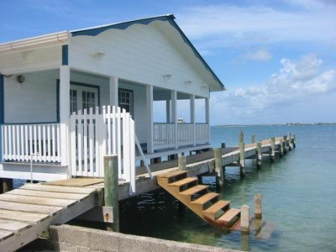
Visiting
Often you visit on Saturday and Sunday in the afternoon; visiting unannounced is common
If having people over have refreshments it’s impolite to refuse
Unexpected visitors arrive at mealtime are extended invitation to eat with family
If you don’t feel like eating, the host will send it home with you

Slide 14
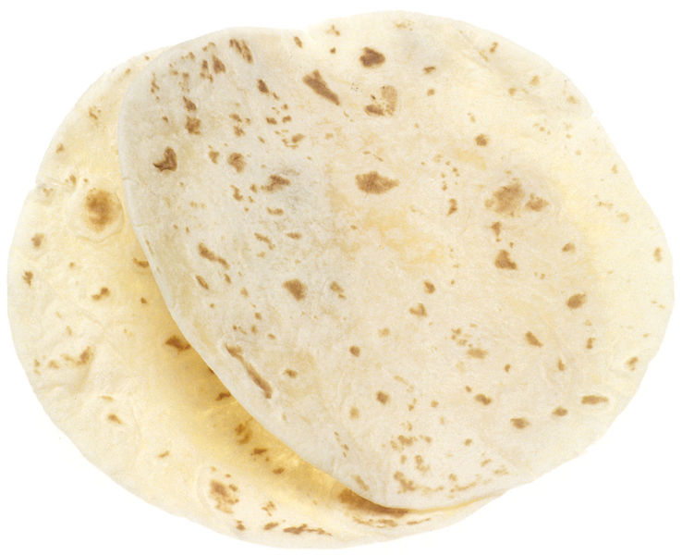
Eating
You eat breakfast between 6 and 8:30am
You eat your main meal at noon, and lighter one at 6-8 pm
Hold fork in right hand and knife in left, urban parts use tortillas instead
A fine restaurants a tip is 10 to 15%

Slide 15
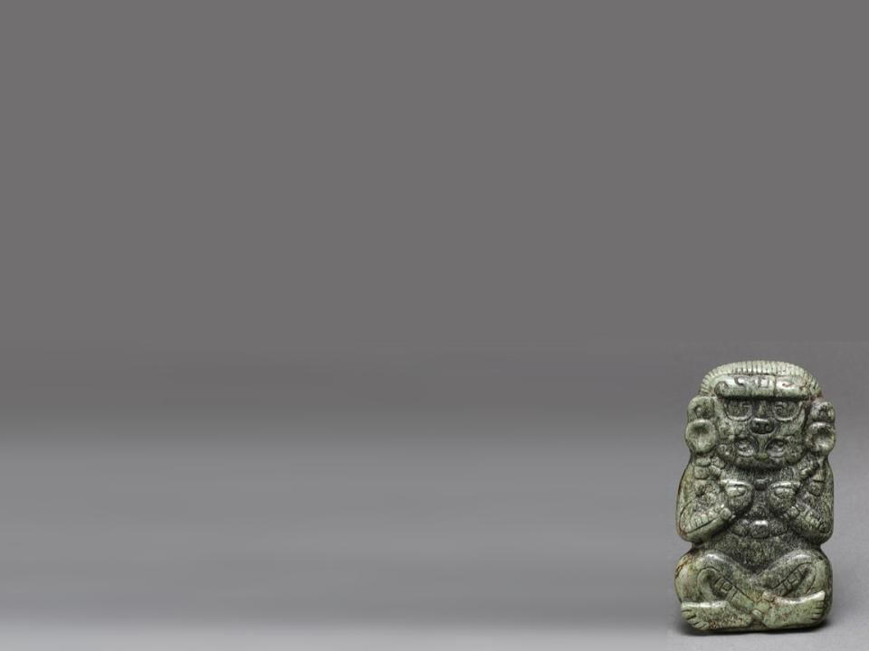
The Arts
Honduras is known for brightly painted ceramic carved trunks, musical instruments, and other woodwork
Pottery and stone carvings were discovered there
Popular kind of music is la putna.
Marimba (similar to xylophone) is a common instrument

Slide 16
Jamie Shipley and Joe Powell created this presentation.

